Slide 1
MD-SAL:
Datastore

Slide 2

MD-SAL: Datastore
概述
数据存储模型
事务
三阶段提交
集群

Slide 3
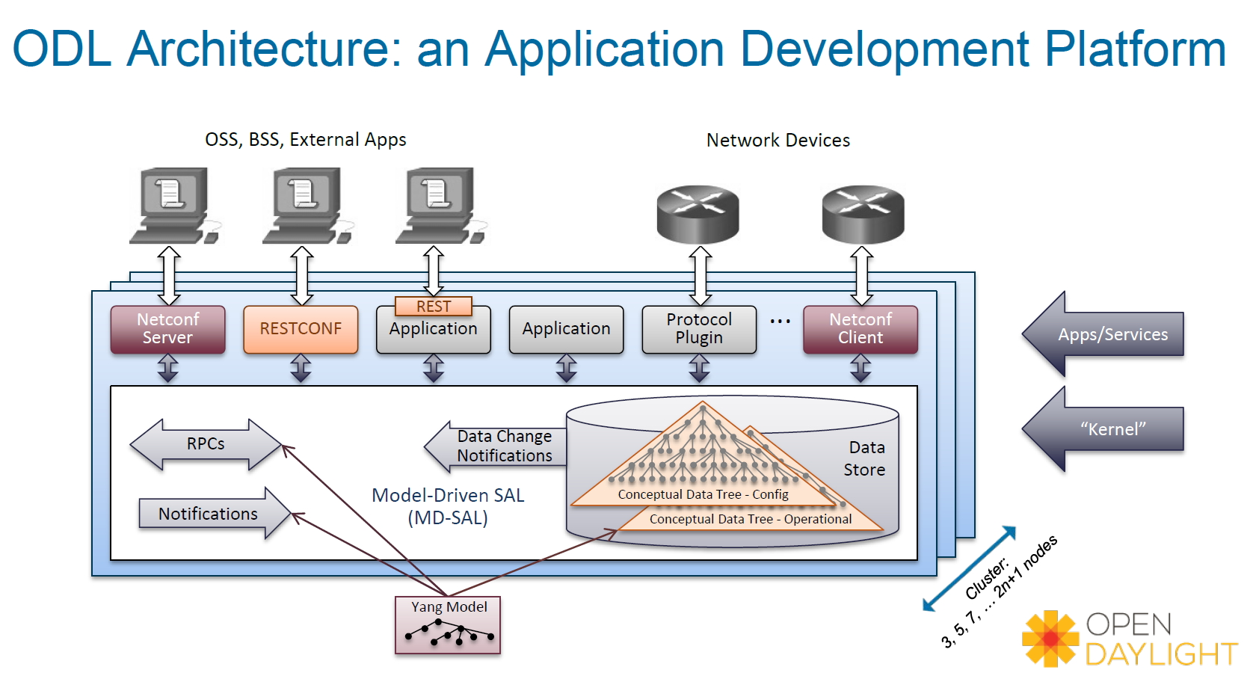
概述

Slide 4
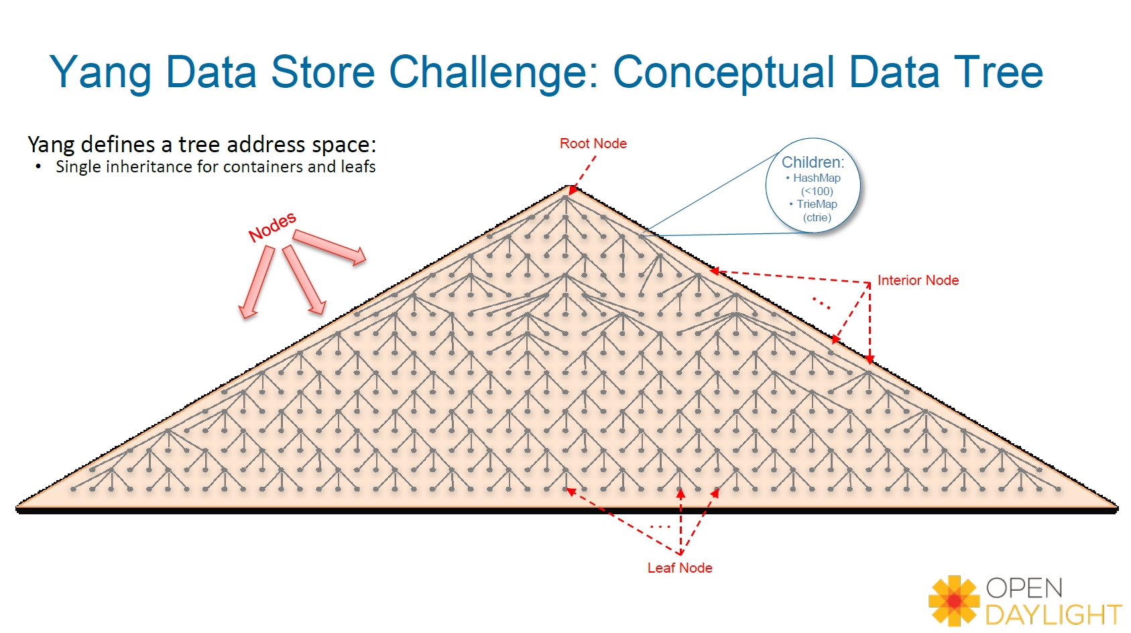
数据存储模型

Slide 5
数据存储模型
DataStore的具体存储形式实际是一棵巨大的树，类似于Linux文件系统，从根节点开始，其中文件夹代表非叶子节点，文件代表叶子节点
每一个节点都代表一个NormalizedNode，其中叶子节点为LeafNode或者LeafSetNode，其它的Node则都属于非叶子节点
非叶子节点才有Children，通过HaspMap或者TrieMap进行描述，根据Yang文件定义的数据格式的层级关系一层一层不断嵌套所形成。

Slide 6
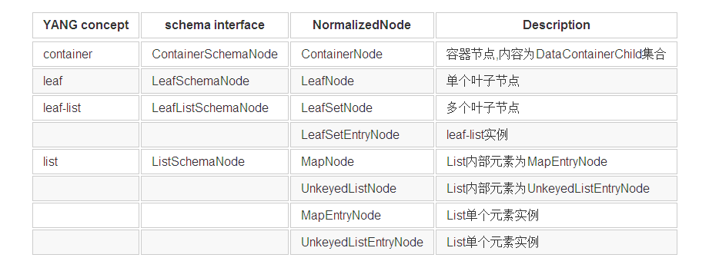
数据存储模型
Yang模型常用数据类型总结

Slide 7
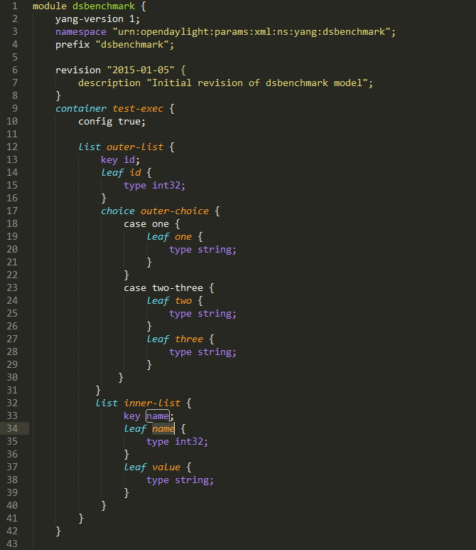
数据存储模型-示例
Dsbenchmark的Yang文件

Slide 8
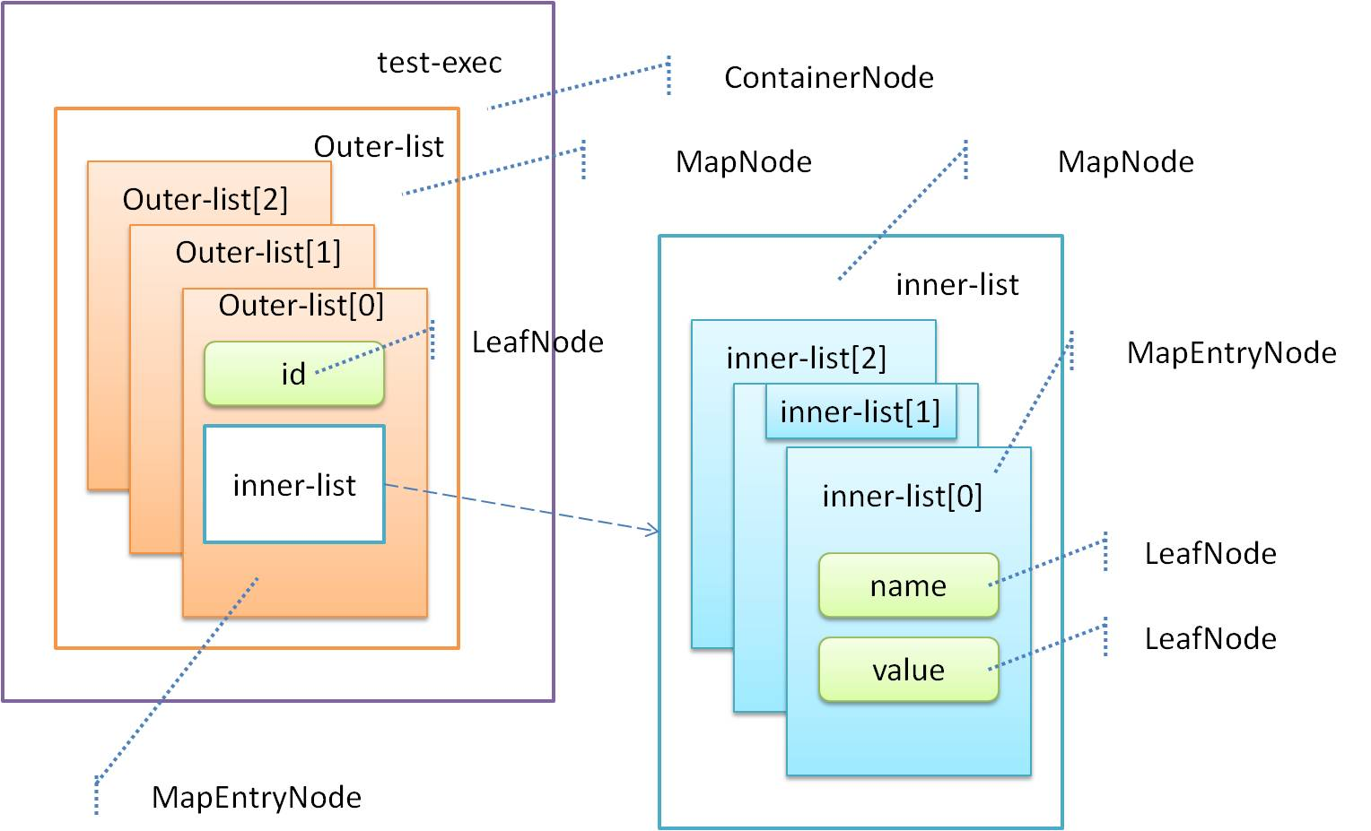
数据存储模型-示例
Dsbenchmark的Yang文件对应的DataTree视图

Slide 9
事务
DataStore的各种数据库访问接口都是通过DataBroker服务以事务的方式进行的
事务特点
事务代表了整个DataTree在某个时刻的一致性视图，该视图在事务创建的时候构造
后续对数据库的一系列操作均基于该一致性视图进行，这些操作整体作为一个原子操作
事务之间彼此隔离，其他事务对数据库的操作不会对当前事务的视图造成影响

Slide 10
事务操作
Read-Only - 只读事务，通过newReadOnlyTransaction()进行创建，通过指定Path读取数据库内容.
Read
Exist
Write-Only - 只写事务，通过newWriteOnlyTransaction()进行创建，操作完成后必须进行submit
Put
Merge
Delete
Read-Write - 读写事务，通过newReadWriteTransaction()进行创建，具备以上两种事务的访问能力.

Slide 11
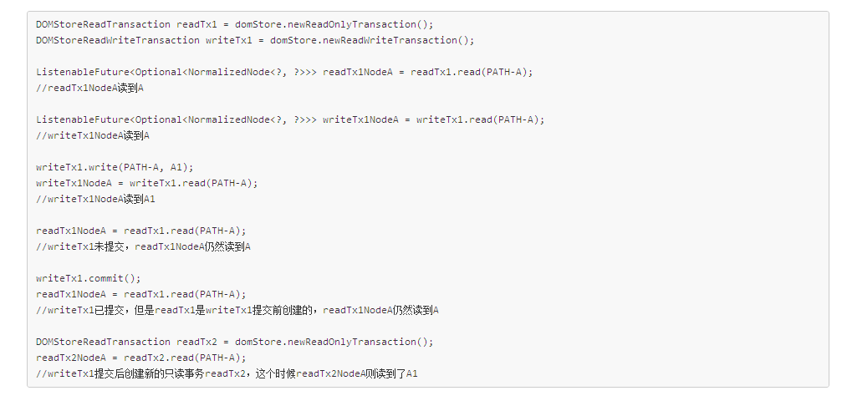
事务隔离
初始化状态下，数据库里面存在两条数据，分别是（PATH-A/A)/(PATH-B/B)
当T1时刻创建一个事务后，那么相当于在T1时刻对整个数据库做了一次快照，后续在该事务上的所有操作都基于该快照进行，可以简单理解为事务拥有了数据库的一份拷贝，这份数据库上的任何修改在未提交前其它事务都无法看到，即使在提交后，假设在T2时刻将操作提交，那么在T2时刻之前创建的其他事务仍然无法看到这个修改，只有当T2时刻后创建的新事务才能看到

Slide 12
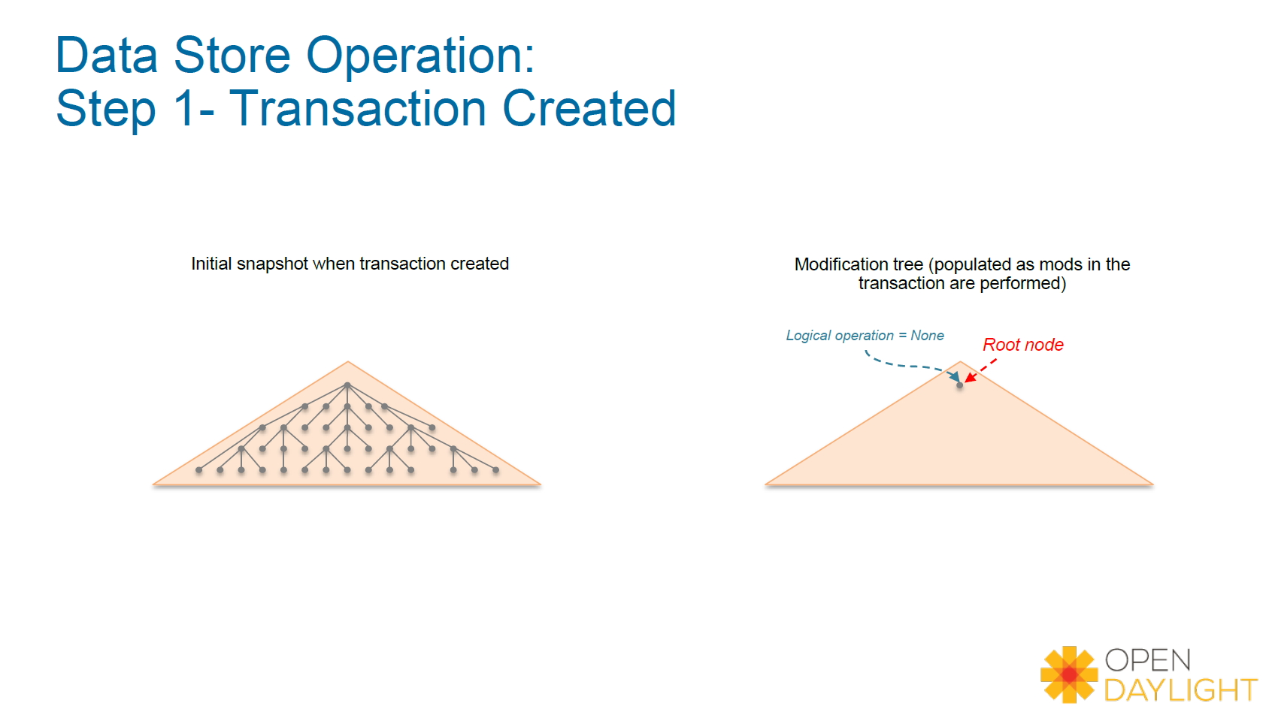
事务过程

Slide 13
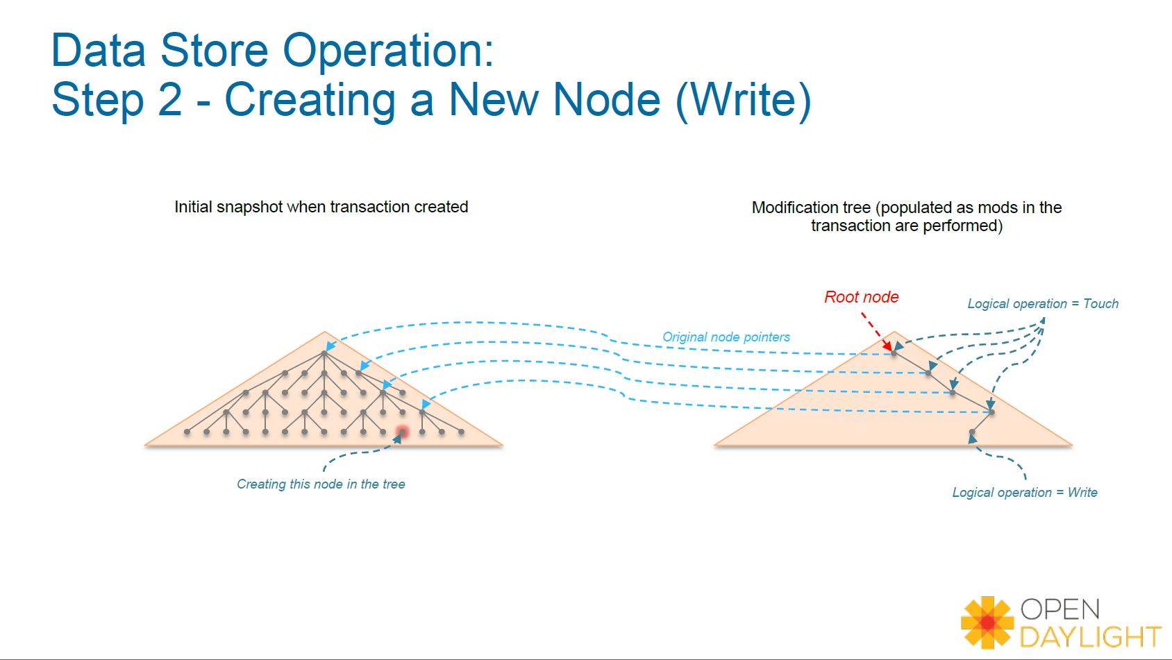
事务过程

Slide 14
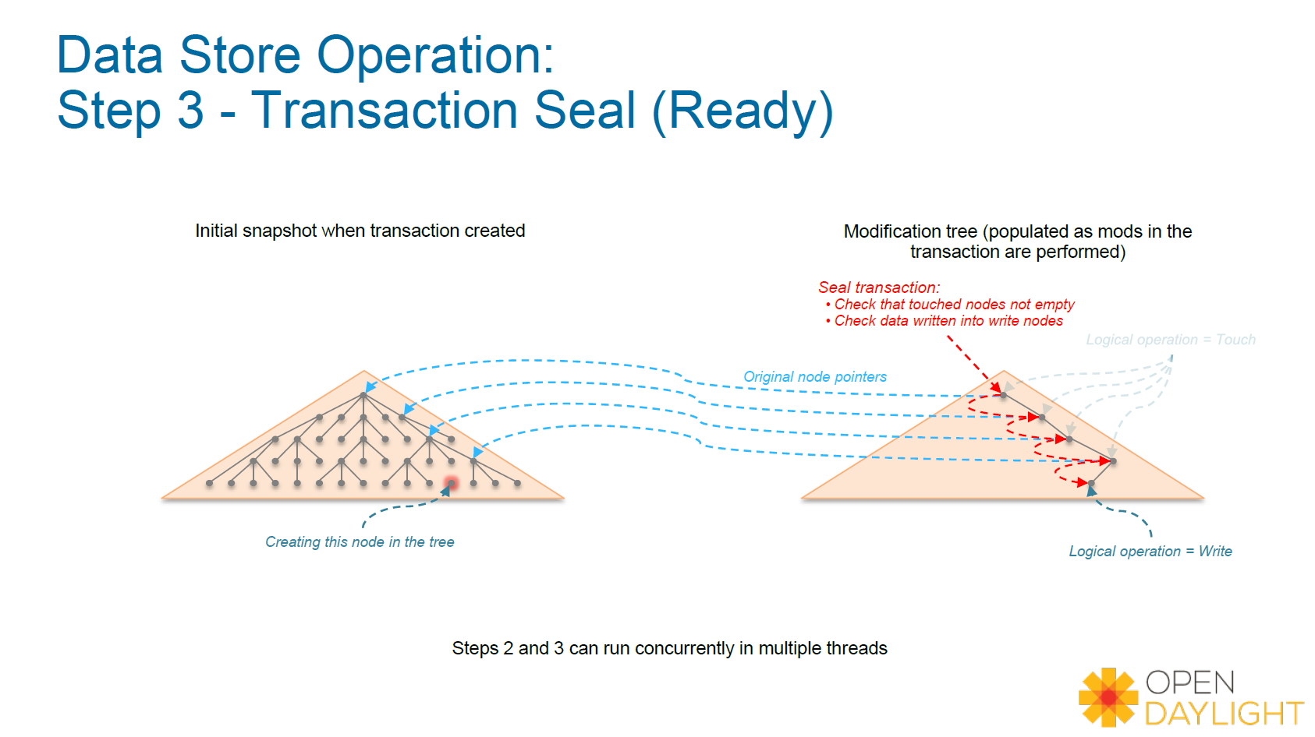
事务过程

Slide 15
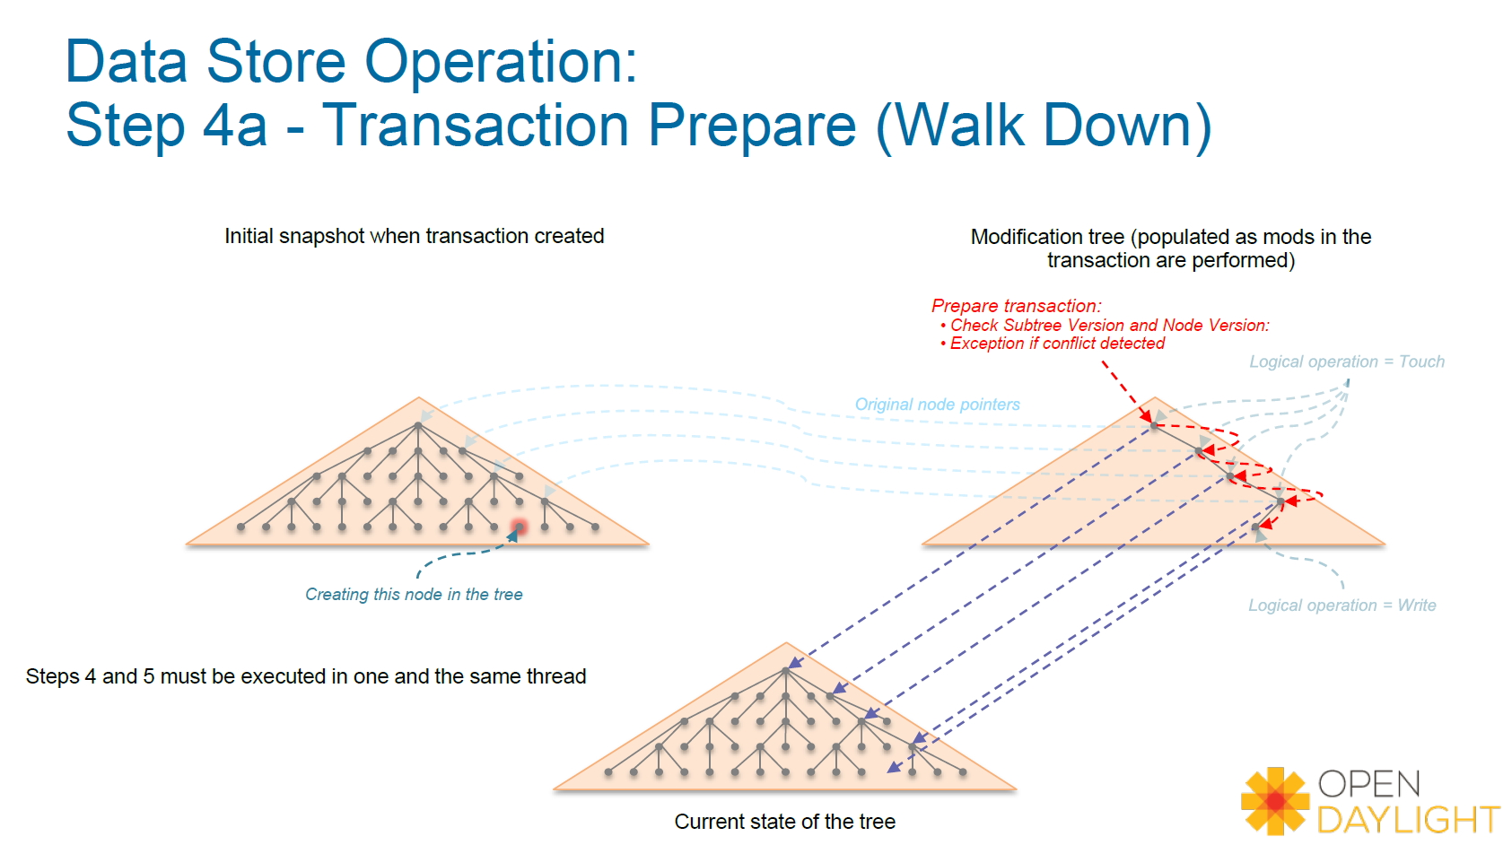
事务过程

Slide 16
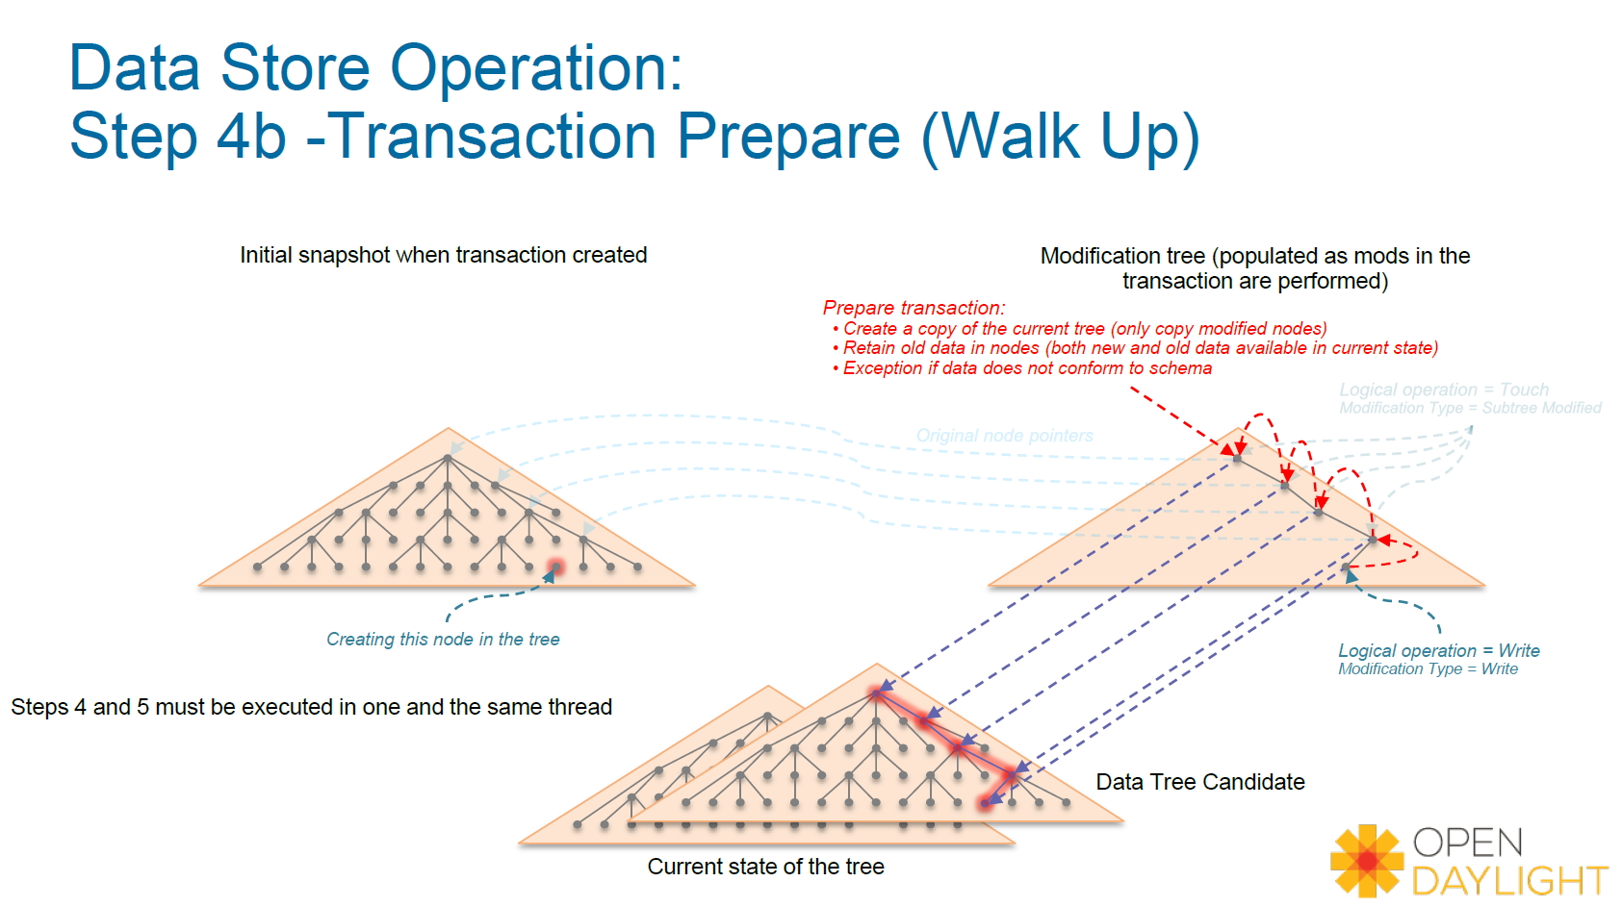
事务过程

Slide 17
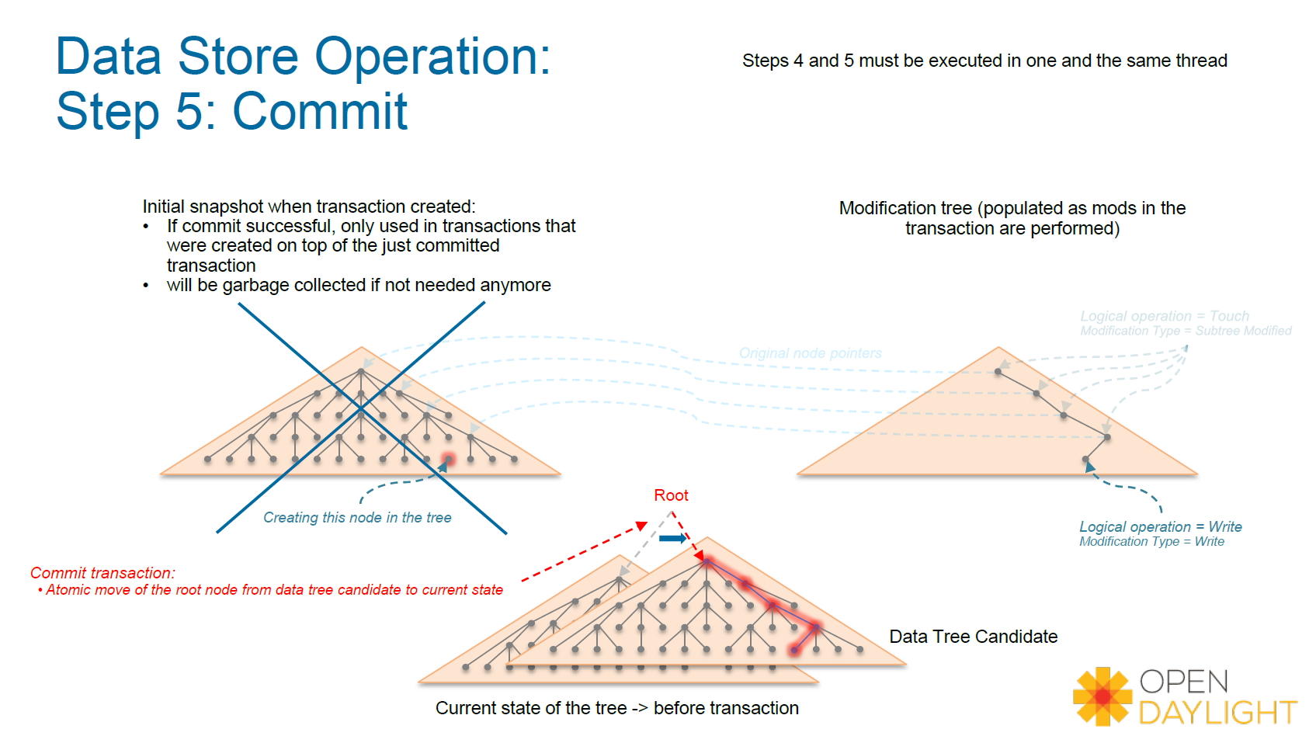
事务过程

Slide 18
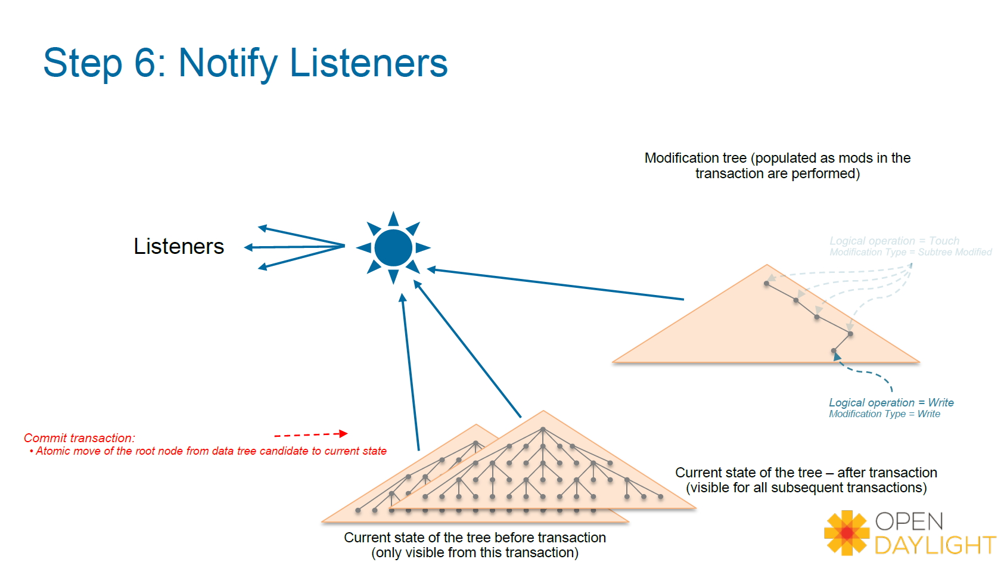
事务过程

Slide 19
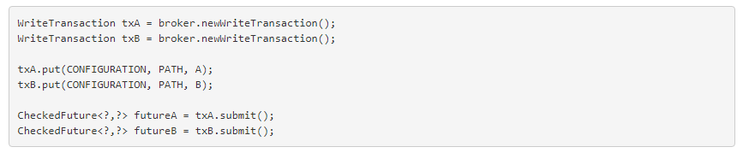
事务Commit失败
Optimistic Lock Failure - 乐观锁冲突
当两个事务都在T1时刻基于相同视图修改共同的节点的时候，后提交的事务将失败，类似于两个用户同时修改相同的Word文档，在最后保存的时候，后保存的用户会提示失败

Slide 20
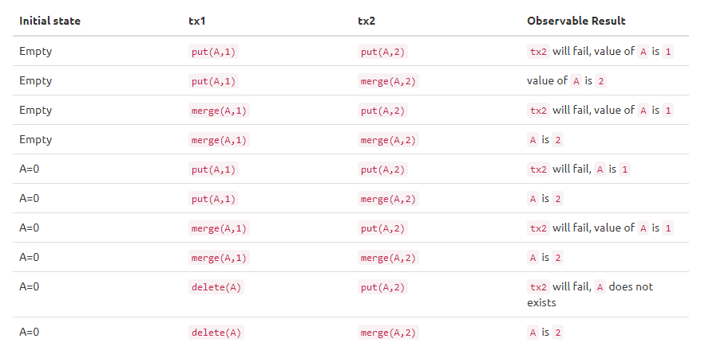
事务并发兼容性

Slide 21
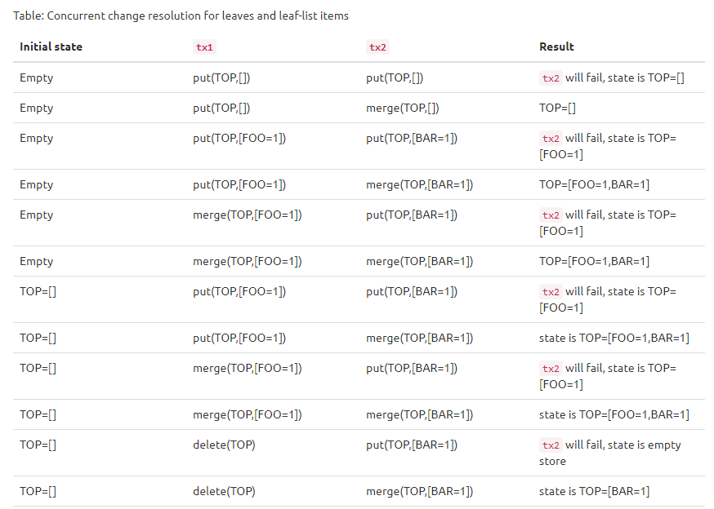
事务并发兼容性

Slide 22
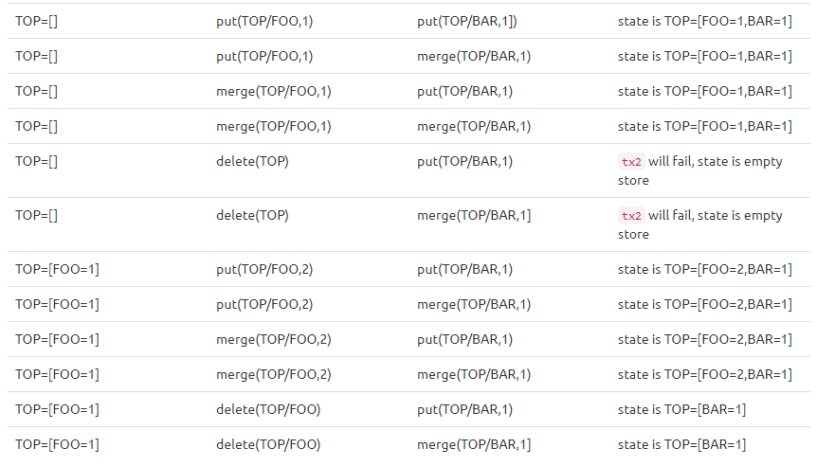
事务并发兼容性

Slide 23
事务链
事务链是事务的API扩展，不同于普通事务创建得到的一致性视图是基于当前DataTree的，事务链创建的事务产生的视图是基于前一个事务执行成功的结果假设(即使上一个事务并没有真正Commit到DataTree中)
事务链本质是一种事务的批处理形式，即将多个事务的提交自动合并成一个或者多个进行.
事务链降低了事务Submit的次数，可以显著提高事务的处理性能.
事务链仅仅是MD-SAL对事务接口API的另一层封装，在DataStore层面是看不到事务链的.

Slide 24
三阶段提交
The Data Store is a participant in the two-phase commit (as a commit handler).
The Request Commit Phase
Changes are applied starting from the deepest nodes in the data tree structure and
then propagated up the tree to the parent node.
Reference to the initial state is captured
Data store creates a new subtree by applying specified operations that affect that node
Data store captures the set of affected data change listeners with the initial state (reference to the old-subtree) and the new state (reference to the new subtree)
Data store propagates the new subtree to the parent node and applies atomic operations on the parent node until the root node of the data store is replaced.

Slide 25
2PC
The Finish Phase
Data store replaces the reference to the root element to newly created root element.
Data store finishes the transaction.
All captured affected listeners are notified with both the initial state and the new state.
The Rollback
Noop, since the reference to consistent (and public snapshot) is changed only in finish
phase. Data Store is only required to not reference newly created tree.

Slide 26
MD-SAL:
Clustering

Slide 27
MD-SAL: Clustering
Distributed Data Store
Shard
Persistence & Recovery
Replication
CAP

Slide 28
Distributed Data Store
Data Broker
Config DataStore
Operational DataStore

Slide 29
Distributed Data Store
Data Broker
Distributed Data Store
Inventory
Shard
InMemoryDataTree
ActorContext
Shard
Manager
Topology
Shard
InMemoryDataTree
Default
Shard
InMemoryDataTree

Slide 30
Distributed Data Store
ShardManager - ShardManager is an actor that creates the shard/shard replicas on system initialization based on configuration(modules.conf/module-shard.conf). It supports the ability to find a Shard and Monitor the Shard's health. It initiates the Shard "Primary" election scheme if any its created primary shards goes down. It also register to get cluster Node UP/DOWN events
ActorContext - The ActorContext class contains utility methods which could be used by to work with actors a little more easily. An ActorContext can be freely passed around to local object instances but should not be passed to actors especially remote actors

Slide 31
Shard
InMemoryDataTree
InMemoryDataTree
Shard
Shard
RaftActor
RaftActor
Akka System
Akka System
Member-1
Member-2

Slide 32
Shard
Shard - A Shard would be a processor which contains some of the data in the system. A Shard being an actor, communication with it would be by means of messages.
Persistence - Since the Shard is a Processor, in accordance with akka-persistence, it is a special actor which when passed a Persistent message will log it to a journal. This journal along with snapshots would be used as a method to recover the state of the DataStore
Module Based Shards
RaftActor - RaftActor encapsulates a state machine that needs to be kept synchronized in a cluster. It implements the RAFT algorithm, RaftActor has 3 states and each state has a certain behavior associated with it. A Raft actor can behave as
A Leader
A Follower
A Candidate

Slide 33
Shard
Akka System - We are going to rely heavily on Akka to provide us the building blocks for our clustering solution. The main components of Akka that we will use are:.
Akka Remoting - Akka Remoting is a communication module for connecting actor systems in a peer-to-peer fashion, and it is the foundation for Akka Clustering.
Akka Clustering - Akka Cluster provides a fault-tolerant decentralized peer-to-peer based cluster membership service with no single point of failure or single point of bottleneck. It does this using gossip protocols and an automatic failure detector
Akka Persistence - Akka persistence enables stateful actors to persist their internal state so that it can be recovered when an actor is started, restarted after a JVM crash or by a supervisor, or migrated in a cluster

Slide 34
Persistence
Everything that gets into a shard is stored in-memory and on the disk
Restarting the controller will reconstitute the state of the shards from the persisted data
Tx.put(path, data)
Tx.submmit()
Shard
Persist Actor
2. ApplyJournalEntries
1. ReplicatedLogEntry
Disk

Slide 35
Recovery
InmemoryDataTree
DataTreeCandidates.applyToModification()
Shard
RaftActorRecoverySupport
2. ApplyJournalEntries
1. ReplicatedLogEntry
3. RecoveryCompleted
Disk

Slide 36
Replication
AppendEntries1
ReplicatedLogEntry1
ReplicatedLogEntry1
ReplicatedLogEntry2
AppendEntries2
ReplicatedLogEntry2
ReplicatedLogEntryN
AppendEntriesN
ReplicatedLogEntryN
Leader
Follower

Slide 37
CAP
2. 1 AppendEntrieReply
Tx.put(path, data)
Tx.submmit()
Leader
1. 1 SendAppendEntrie
Follower-1
4.1 Submit SuccessFull
1. 2 SendAppendEntrie
3.1 Tx.Commit()
Follower-2
InmemoryDataTree
2. 2 AppendEntrieReply

Slide 38
Akka Persistence

Slide 39
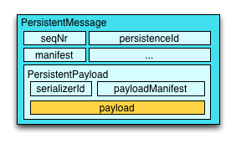
Akka Persistence
Akka 持久化功能能够使得有状态的Actor能够保存它的内部状态，当该Actor重启的时候能够迅速恢复到失效之前的状态
为了达到以上的目的，Akka的持久化分为以下两部分
Journal Persistence
Snapshot Persistence

Slide 40
Akka Journal Persistence
Akka日志持久化的内容是那些影响Actor状态变化的事件信息，而不是当前状态本身
例如某个代表银行账户的Actor，账户余额则是当前状态结果，而导致余额变化的则是存入和支出的事件信息，持久化的内容则是按时间序列记录的存入和支出的具体金额，Acotr恢复过程中则通过重放每一条记录恢复余额最终的状态

Slide 41
Akka Snapshot Persistence
与日志持久化相反，Akka快照持久化的内容是Actor状态本身的结果信息
例如在某个时间点将银行账户的Actor的余额信息进行持久化记录

Slide 42
Akka Persistence Recovery
Snapshot records
T5
1300
T6 | T7 | T8
+200 | -100 | +50
Journal records
Actor恢复的时候先从snapshot恢复到T5时刻的状态，然后再逐一读取Journal恢复到最后T8的状态

Slide 43
THANKS

